Slide 1
NBA Spread Prediction
By:
Bryce Anthony , Archie Frank, Michael d’Amore, John Miller, Mervin McDougall

Slide 2
Problem Definition
Goal: To predict the NBA winning team and the point spread using a neural network.
The surge of online sports betting industry
What is a spread?
Win-loss prediction
More informed betting decisions
Notes:
Spread is a derived feature which calculated from the difference between the home team points and away team points.

Slide 3
Data Sources and Scraping
Basketball Reference -https://www.basketball-reference.com/
NBA Stats - https://www.nba.com/stats
Data Scrape (python) and CSV download
Advanced Stats:
PER (Player Efficiency Rating) – All-in-one basketball rating, that boils down all of a player's contributions into one number. Using a detailed formula it rates every player's statistical performance.(It has drawbacks)
WS (Win Shares) - The estimated amount of wins a contributed by a player
AST% (Assist Percentage) - An estimate of the percentage of teammate field goals a player assisted on while on the court
VORP (Value over Replacement Player) -A box score estimate of the points per 100 TEAM possessions that a player contributed above a replacement level player, translated to an average team and proportional to an 82 game season
BMP (Box Plus Minus) – Estimate the player's contribution in points above league average per 100 possessions played.
OBMP (Offensive Box Plus Minus) - a statistic that measures a player's impact on team offense
DBMP (Defensive Box Plus Minus) - a statistic that measures a player's impact on team defense

Slide 4
Exploratory Data Analysis
Arena, Home Team, and Away Team data was converted to sparse matrices
Spread was not included but was derived from home team points and away team points
Correlated features identified during the EDA were removed. Eg. home_fta, which is correlated with home_fta_pct
Notes:
Feature sets for EDA: home_team_input, away_team_input, home_avg_stats_input, away_avg_stats_input, arena_input, home_AST%_input, away_AST%_input, home_TOV%_input, away_TOV%_input, home_OBPM_input, away_OBPM_input, home_FTr_input, away_FTr_input, home_DRB%_input, away_DRB%_input, home_WS_input, away_WS_input, home_PER_input, away_PER_input, home_BLK%_input, away_BLK%_input

Slide 5
Training and Experimentation
Gelu. (best response)
SeLu
Swish
Mish
ReLu
Lazy ReLu
Soft Max
Soft Plus
Adam
AdaMax
Nadam (best response)
Batch normalization
Dropout training
Transfer Learning
Bucketization of outcome
Feature selection

Slide 6
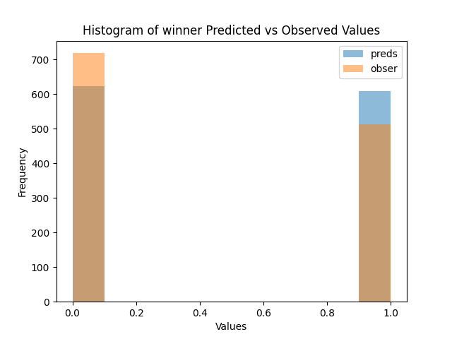
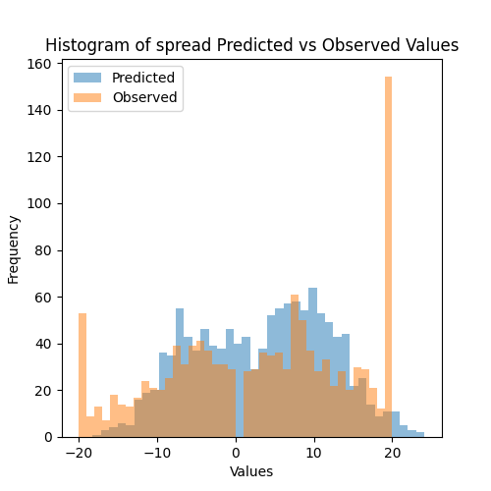
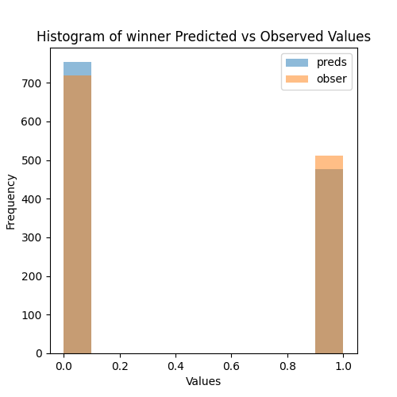
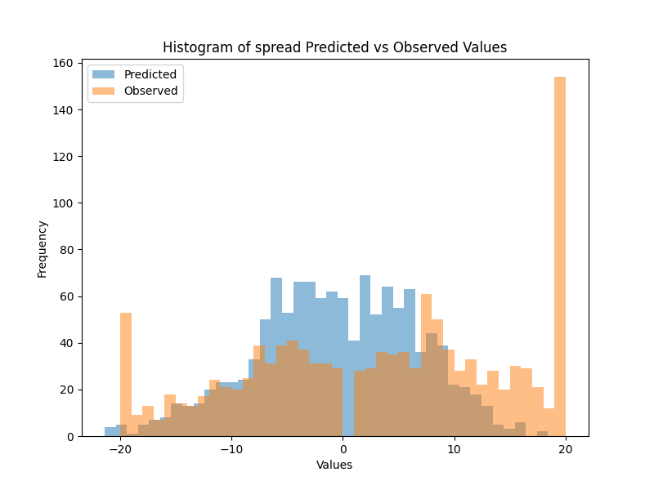
Results
Win loss somewhat accurate prediction but our spread is not accurate. Our model is overfitting the training data. Our conclusion is that predicting the spread goes beyond the statistics and data we have access to. The following results depict findings having trained on 2016 and tested on 2017 data.

Slide 7
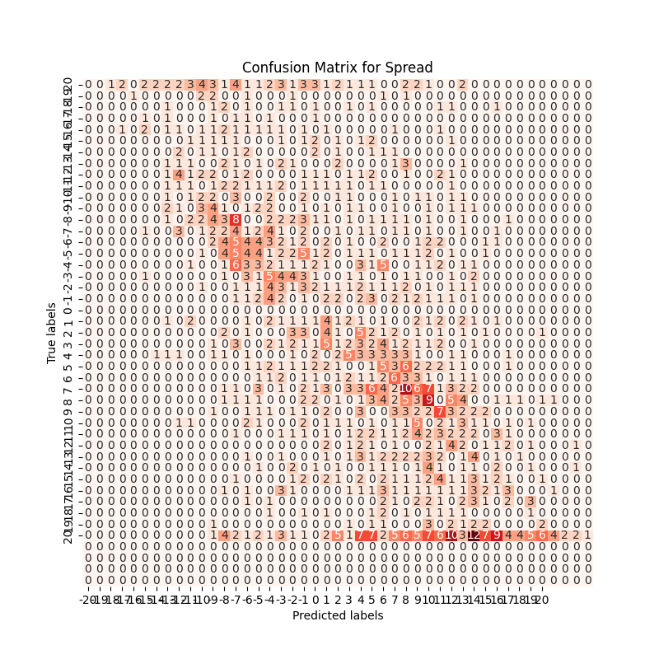
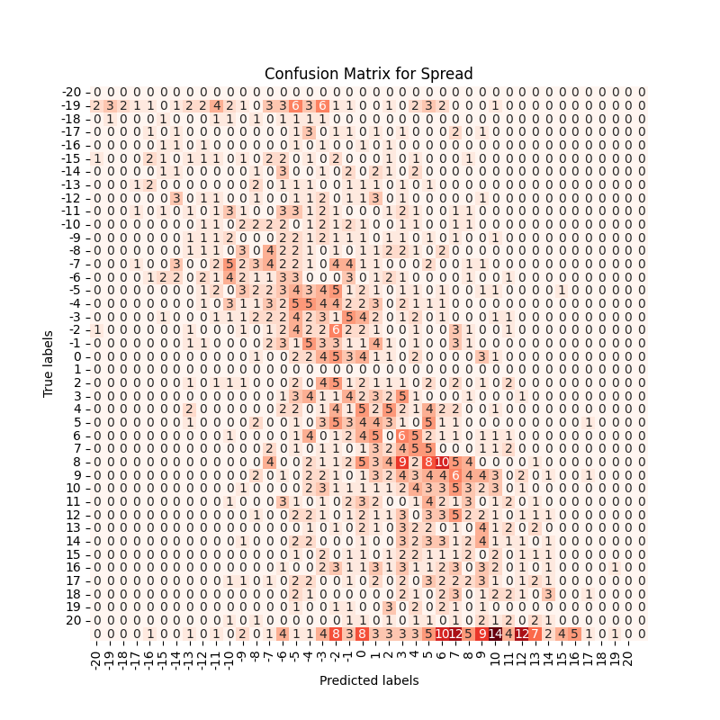
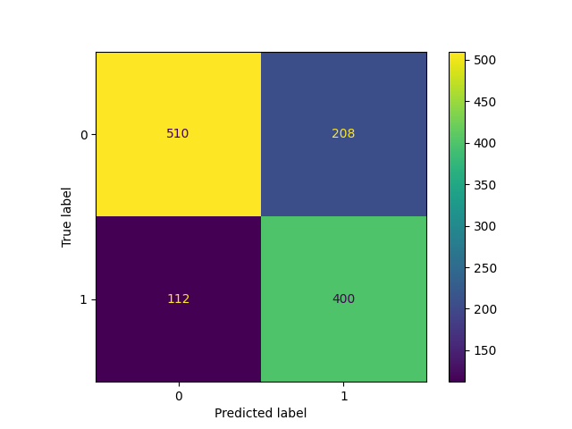
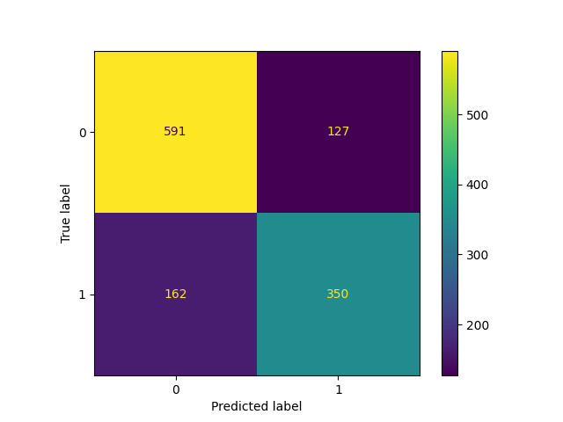
Test Results:
Accuracy: 73.98
F1-score : 76.12%
Precision score: 81.99%:
Recall score : 81.9%
Train Results:
Accuracy: 76.50 %
F1-score : 80.35 %
Precision score: 78.49%:
Recall score : 78.48%
0 = home team win
1= home team loss

